Slide 2

Data manipulation with dplyr (aka tidyverse)
Notes:
So if you made the observation that data manipulation in what we call “Base R” is a bit clunky & hard to read, you’d be right.
It turns out that there are some more modern tools that will probably streamline things a bit.
By the end of today you’ll know two different ways of manipulating a data.frame …. But that’s not necessarily a bad thing.

Slide 3
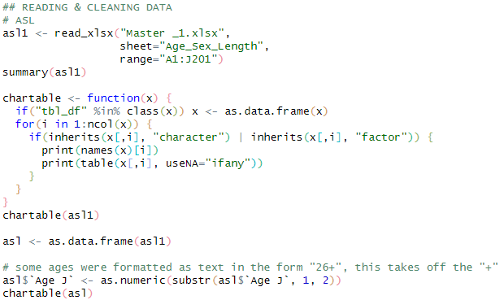
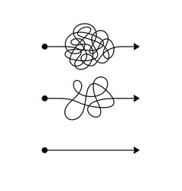
Motivation: Matt’s typical Base R data workflow…
Import MyDataFrame
MyDataFrame1
MyDataFrame2
MyDataFrame3
MyDataFrame4
Notes:
To illustrate the problem that dplyr and tidyverse solve, here’s a bit of schematic of my typical data workflow using base R.
I would import my data, do some complicated stuff with it (using square brackets and dollar signs and for-loops and tapply and all sorts of stuff we haven’t talked about yet)
probably need to create a new data.frame called “dataframe1”, then do some more complicated stuff which would get called “dataframe2”…

Slide 4
Motivation: Matt’s typical Base R data workflow…
Import MyDataFrame
Baked-from-scratch syntax
Probably difficult to read for anybody other than Matt (who wrote it)
Which probably includes next-year Matt!
Requires Matt to re-create the syntax correctly every time
Has he had coffee yet?
MyDataFrame1
MyDataFrame2
MyDataFrame3
MyDataFrame4
Notes:
And you’ll notice that all these steps involve writing all the syntax from scratch
Which, let’s face it, WILL be hard to read and understand
And lots of opportunities to introduce human error

Slide 5
Motivation: Matt’s typical Base R data workflow…
Import MyDataFrame
Create incremental data.frames?
This creates workspace clutter
Is Matt using the right one?
Or overwrite the original data.frame with every step?
SCARY!!!
MyDataFrame1
MyDataFrame2
MyDataFrame3
MyDataFrame4
Notes:
You’ll ALSO notice that I kept having to create these partially-finished THINGS. Do you see how that could create problems?
- either I end up overwriting the original (out of order problems)
- or I end up creating things I could accidentally use instead
Because I’m not likely to remember that the final data set is myDataFrame4!

Slide 6
But first, introducing the pipe operator %>%
Rule: the %>% moves the
LHS object
to the first position of the
RHS function
x %>% function1
- Is evaluated as -
function1(x)
x %>% function1(someArgs1)
- Is evaluated as -
function1(x, someArgs1)
Notes:
So hold that mental picture in your mind, while we introduce a new, extremely powerful operator: the PIPE.
What the pipe does “officially” is to move the LHS OBJECT to the FIRST POSITION of the RHS FUNCTION.

Slide 7
But first, introducing the pipe operator %>%
Rule: the %>% moves the
LHS object
to the first position of the
RHS function
Conversely, a piped statement begins with an object, and takes a function as its second operand
function1(x)
- becomes -
x %>% function1
x %>% function1
- is evaluated as -
function1(x)
Mental model:
What you started with
What happens to it
x %>% function1(someArgs1)
function1(x, someArgs1)
- is evaluated as -
- becomes -
function1(x, someArgs1)
x %>% function1(someArgs1)
Notes:
And it’s a lot easier to think of this the other way around.
A piped statement starts with an object, and ends with a function.
So essentially, this becomes THE THING YOU START WITH, then THE THING THAT HAPPENS TO IT.
And maybe there are some additional arguments associated with the thing that happens.

Slide 8
Where this matters: if you have a sequence of operations
function3(function2(function1(x, someArgs1), someArgs2), someArgs3)
Or equivalently
function3(
function2(
function1(x, someArgs1),
someArgs2),
someArgs3)
x %>%
function1(someArgs1) %>%
function2(someArgs2) %>%
function3(someArgs3)
Can be rewritten as
Notes:
Where this really matters is if you have a whole sequence of operations.
You COULD write it as a nested function call, and it would work… but it’s much more natural (and also readable) to write the steps in sequence.

Slide 9
Where this matters: if you have a sequence of operations
function3(function2(function1(x, someArgs1), someArgs2), someArgs3)
What you started with
Or equivalently
What happens to it
function3(
function2(
function1(x, someArgs1),
someArgs2),
someArgs3)
x %>%
function1(someArgs1) %>%
function2(someArgs2) %>%
function3(someArgs3)
Then what happens to that
Can be rewritten as
Then what happens to that…
Notes:
So remember, we have this mental model of the thing we started with, then what happens to it…

Slide 10

The dplyr package (part of tidyverse)
Provides a set of functions (“verbs”) for typical data operations
All of these take a data.frame as their first argument, and return a data.frame
This means you can %>% a whole sequence in one pipeline!!
myDataFrame %>%
dataVerb1(someArgs1) %>%
dataVerb2(someArgs2) %>%
dataVerb3(someArgs3)
Notes:
Ok, so next piece of the puzzle… and it’s about to start making sense.
The dplyr package (or tidyverse, for lazy people like me)…
…and what makes this possible is that all the dplyr functions (or data verbs) have a data.frame input AND data.frame output. That means you can chain them all together!

Slide 11
Motivation: Matt’s typical Base R data workflow…
Import MyDataFrame
%>%
dataVerb1(someArgs1)
%>%
MyDataFrame1
dataVerb2(someArgs2)
%>%
MyDataFrame2
dataVerb3(someArgs3)
%>%
MyDataFrame3
dataVerb4(someArgs4)
MyDataFrame4
Notes:
So revisiting our “motivating example”…
We can replace all the complicated syntax with single functions…
And we can replace all the incomplete “things” with pipes to the next step

Slide 12

LET ME SUM UP
Import MyDataFrame
%>%
Result…
Code is more concise
Code is easier to read
No incomplete objects are created
Fewer opportunities for human error
dataVerb1(someArgs1)
%>%
dataVerb2(someArgs2)
%>%
dataVerb3(someArgs3)
%>%
dataVerb4(someArgs4)
Notes:
And as a final result…
…and in practice, you will end up constructing the pipeline one piece at a time.

Slide 13
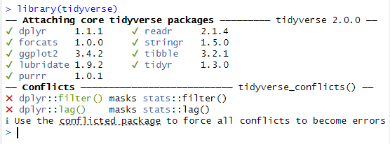
What is the Tidyverse?
The Tidyverse is a collection of packages that extend the usefulness of R, use slightly different language syntax, and play well together
I usually just load the tidyverse package (I’m lazy)
These are all the packages that get loaded at once
Letting you know that there are functions with these names in multiple packages
Notes:
So let’s explicitly talk about what I mean when I say “tidyverse”
The Tidyverse is a collection of packages that all work well together, and I usually just load them all at once because I can never remember which functions are where.
Notice that DPLYR is one of these, but there are others.

Slide 14
First, some fake data…
catchdata <- data.frame(station = c(1, 1, 2, 2, 3, 3),
catch = c(12, 23, 44, 65, 34, 49),
hours = c(1, 2, 2, 3, 1, 1.5),
weather = c("sun", "sun", "rain", "rain", "rain", "flood"))
catchdata
station catch hours weather
1 1 12 1.0 sun
2 1 23 2.0 sun
3 2 44 2.0 rain
4 2 65 3.0 rain
5 3 34 1.0 rain
6 3 49 1.5 flood
Notes:
So! There are a bajillion functions in the tidyverse, and we’ve only got time for the greatest hits.
And we’ll work through some examples to give you an idea.
But first, here’s some fake data. A nice little toy data.frame.

Slide 15
select(): only keep certain columns
Note: in dplyr syntax, you no longer need the $, since the function already knows to look inside the data.frame you use with it
catchdata %>% select(station, catch)
station catch
1 1 12
2 1 23
3 2 44
4 2 65
5 3 34
6 3 49
catchdata
station catch hours weather
1 1 12 1.0 sun
2 1 23 2.0 sun
3 2 44 2.0 rain
4 2 65 3.0 rain
5 3 34 1.0 rain
6 3 49 1.5 flood
This is the same as
select(catchdata, station, catch)
select - filter - mutate - rename - etc!
Notes:
Select() is the tidyverse way of selecting a subset of COLUMNS
You’re right, you already know how to do that, but this is the tidyverse way to do it.
And actually, I think the code is a LOT cleaner to read!
And it’s worth noting that we no longer need the dollar sign operator…

Slide 16
select(): only keep certain columns
Note: in dplyr syntax, you no longer need the $, since the function already knows to look inside the data.frame you use with it
catchdata %>% select(station, catch)
station catch
1 1 12
2 1 23
3 2 44
4 2 65
5 3 34
6 3 49
catchdata
station catch hours weather
1 1 12 1.0 sun
2 1 23 2.0 sun
3 2 44 2.0 rain
4 2 65 3.0 rain
5 3 34 1.0 rain
6 3 49 1.5 flood
catchdata %>% select(-hours, -weather)
Same result with negative column names
select - filter - mutate - rename - etc!
Notes:
And if it’s helpful, we can be really visually explicit about what it’s selecting.
And just like we could use negative indices in square brackets, we can also EXCLUDE things with negative signs here.

Slide 17
select(): only keep certain columns
Note: in dplyr syntax, you no longer need the $, since the function already knows to look inside the data.frame you use with it
catchdata %>% select(station, catch)
station catch
1 1 12
2 1 23
3 2 44
4 2 65
5 3 34
6 3 49
catchdata
station catch hours weather
1 1 12 1.0 sun
2 1 23 2.0 sun
3 2 44 2.0 rain
4 2 65 3.0 rain
5 3 34 1.0 rain
6 3 49 1.5 flood
Is there a Base R equivalent?
catchdata[ , 1:2]
Not obvious to a reader
Not as robust to changes to the data!
data.frame(station=catchdata$station, catch=catchdata$catch)
Lots of extra typing
catchdata[ , c("station", "catch")]
Kinda messy!
catchdata %>% select(-hours, -weather)
Same result with negative column names
select - filter - mutate - rename - etc!
Notes:
Is there a Base R equivalent?
Of course there is, and you already know of a couple of them.

Slide 18
filter(): only keep certain rows
Any logical vector will be fine here
catchdata
station catch hours weather
1 1 12 1.0 sun
2 1 23 2.0 sun
3 2 44 2.0 rain
4 2 65 3.0 rain
5 3 34 1.0 rain
6 3 49 1.5 flood
catchdata %>% filter(station %in% 1:2)
station catch hours weather
1 1 12 1 sun
2 1 23 2 sun
3 2 44 2 rain
4 2 65 3 rain
select - filter - mutate - rename - etc!
Notes:
Filter is select’s counterpart, and it gives a subset of ROWS instead of columns.
And this is what filter() looks like.
Any logical statement will work here, and we already know how to build those!

Slide 19
filter(): only keep certain rows
Any logical vector will be fine here
catchdata
station catch hours weather
1 1 12 1.0 sun
2 1 23 2.0 sun
3 2 44 2.0 rain
4 2 65 3.0 rain
5 3 34 1.0 rain
6 3 49 1.5 flood
catchdata %>% filter(station %in% 1:2)
station catch hours weather
1 1 12 1 sun
2 1 23 2 sun
3 2 44 2 rain
4 2 65 3 rain
select - filter - mutate - rename - etc!
Notes:
And we can make it visual & explicit if it’s helpful:
It looks at STATION, and returns ROWS where this condition is met.

Slide 20
filter(): only keep certain rows
Any logical vector will be fine here
catchdata
station catch hours weather
1 1 12 1.0 sun
2 1 23 2.0 sun
3 2 44 2.0 rain
4 2 65 3.0 rain
5 3 34 1.0 rain
6 3 49 1.5 flood
catchdata %>% filter(station %in% 1:2)
station catch hours weather
1 1 12 1 sun
2 1 23 2 sun
3 2 44 2 rain
4 2 65 3 rain
Is there a Base R equivalent?
catchdata[ catchdata$station %in% 1:2, ]
A little extra typing
A reader might not know what the square brackets mean
select - filter - mutate - rename - etc!
Notes:
Is there a base R equivalent? Yeah, totally.

Slide 21
mutate(): make (or transform) columns
Rule: ColName = Formula…
catchdata %>% mutate(catch_rate = catch/hours)
station catch hours weather catch_rate
1 1 12 1.0 sun 12.00000
2 1 23 2.0 sun 11.50000
3 2 44 2.0 rain 22.00000
4 2 65 3.0 rain 21.66667
5 3 34 1.0 rain 34.00000
6 3 49 1.5 flood 32.66667
catchdata
station catch hours weather
1 1 12 1.0 sun
2 1 23 2.0 sun
3 2 44 2.0 rain
4 2 65 3.0 rain
5 3 34 1.0 rain
6 3 49 1.5 flood
select - filter - mutate - rename - etc!
Notes:
Mutate() gives you a way of making new columns, or else transforming existing ones. And we’ll look at a quick example of each.
Here we’re making a NEW column CATCH RATE, that’s calculated by CATCH DIVIDED BY HOURS
And here’s how the mutate() syntax works: The new column name, and the formula to calculate it. And notice that this is a vector operation just like we learned yesterday!

Slide 22
mutate(): make (or transform) columns
Rule: ColName = Formula…
catchdata %>% mutate(catch_rate = catch/hours)
station catch hours weather catch_rate
1 1 12 1.0 sun 12.00000
2 1 23 2.0 sun 11.50000
3 2 44 2.0 rain 22.00000
4 2 65 3.0 rain 21.66667
5 3 34 1.0 rain 34.00000
6 3 49 1.5 flood 32.66667
catchdata
station catch hours weather
1 1 12 1.0 sun
2 1 23 2.0 sun
3 2 44 2.0 rain
4 2 65 3.0 rain
5 3 34 1.0 rain
6 3 49 1.5 flood
select - filter - mutate - rename - etc!
Notes:
So dissecting where all the parts come from…

Slide 23
mutate(): make (or transform) columns
Rule: ColName = Formula…
catchdata %>% mutate(catch_rate = catch/hours)
station catch hours weather catch_rate
1 1 12 1.0 sun 12.00000
2 1 23 2.0 sun 11.50000
3 2 44 2.0 rain 22.00000
4 2 65 3.0 rain 21.66667
5 3 34 1.0 rain 34.00000
6 3 49 1.5 flood 32.66667
catchdata
station catch hours weather
1 1 12 1.0 sun
2 1 23 2.0 sun
3 2 44 2.0 rain
4 2 65 3.0 rain
5 3 34 1.0 rain
6 3 49 1.5 flood
Is there a Base R equivalent?
catchdata$catch_rate <- catchdata$catch / catchdata$hours
This one’s actually not so bad
select - filter - mutate - rename - etc!
Notes:
And of course there’s a base R equivalent, and you probably already know it!

Slide 24
mutate(): make (or transform) columns
Rule: ColName = Formula…
Value if TRUE
Value if FALSE
Logical
catchdata %>%
mutate(weather = ifelse(weather=="sun", "SUN!", weather))
station catch hours weather
1 1 12 1.0 SUN!
2 1 23 2.0 SUN!
3 2 44 2.0 rain
4 2 65 3.0 rain
5 3 34 1.0 rain
6 3 49 1.5 flood
catchdata
station catch hours weather
1 1 12 1.0 sun
2 1 23 2.0 sun
3 2 44 2.0 rain
4 2 65 3.0 rain
5 3 34 1.0 rain
6 3 49 1.5 flood
Note that vectors can be used!
select - filter - mutate - rename - etc!
Notes:
Here’s mutate() used to transform an existing column, let’s say I want to programmatically replace some values.
Here it is with an ifelse() statement …remember, that’s a SEPARATE function we saw yesterday! We can totally use functions within functions!
The ifelse() checks if the weather is “sun” and if so, it makes it “SUN!” And LEAVES IT ALONE otherwise – that’s the magic of the vector input.

Slide 25
mutate(): make (or transform) columns
Rule: ColName = Formula…
Value if TRUE
Value if FALSE
Logical
catchdata %>%
mutate(weather = ifelse(weather=="sun", "SUN!", weather))
station catch hours weather
1 1 12 1.0 SUN!
2 1 23 2.0 SUN!
3 2 44 2.0 rain
4 2 65 3.0 rain
5 3 34 1.0 rain
6 3 49 1.5 flood
catchdata
station catch hours weather
1 1 12 1.0 sun
2 1 23 2.0 sun
3 2 44 2.0 rain
4 2 65 3.0 rain
5 3 34 1.0 rain
6 3 49 1.5 flood
Note that vectors can be used!
select - filter - mutate - rename - etc!
Notes:
Maybe this is overkill, but we’ll get fancy with the colors again.
Here are the cases where that test returns TRUE … here are the cases where it returns FALSE …
And here’s the TRANSFORMED weather column.

Slide 26
mutate(): make (or transform) columns
Rule: ColName = Formula…
Value if TRUE
Value if FALSE
Logical
catchdata %>%
mutate(weather = ifelse(weather=="sun", "SUN!", weather))
station catch hours weather
1 1 12 1.0 SUN!
2 1 23 2.0 SUN!
3 2 44 2.0 rain
4 2 65 3.0 rain
5 3 34 1.0 rain
6 3 49 1.5 flood
catchdata
station catch hours weather
1 1 12 1.0 sun
2 1 23 2.0 sun
3 2 44 2.0 rain
4 2 65 3.0 rain
5 3 34 1.0 rain
6 3 49 1.5 flood
Note that vectors can be used!
Is there a Base R equivalent?
catchdata$weather[catchdata$weather=="sun"] <- "SUN!"
This one’s actually not so bad
select - filter - mutate - rename - etc!
Notes:
And in base R, we could use THAT SAME LOGICAL STATEMENT within square brackets to accomplish the same thing, but maybe it’s kinda messy.
And of course the advantage of using a tidyverse function is that we can keep the pipeline intact if we’re using one.

Slide 27
rename(): rename columns
Check it out! It’s a pipeline!!!
Rule: NewColName = OldColName
catchdata %>%
select(station, catch) %>%
rename(Station_num=station, Coho_catch=catch)
Station_num Coho_catch
1 1 12
2 1 23
3 2 44
4 2 65
5 3 34
6 3 49
catchdata
station catch hours weather
1 1 12 1.0 sun
2 1 23 2.0 sun
3 2 44 2.0 rain
4 2 65 3.0 rain
5 3 34 1.0 rain
6 3 49 1.5 flood
select - filter - mutate - rename - etc!
Notes:
Ok, rename() is actually awesome. Even if it doesn’t LOOK that awesome, it’s great.
And since it’s fairly obvious what rename() does (spoiler alert: it renames columns), I’ll risk doing two things at once and show you a PIPELINE.

Slide 28
rename(): rename columns
Check it out! It’s a pipeline!!!
Rule: NewColName = OldColName
catchdata %>%
select(station, catch) %>%
rename(Station_num=station, Coho_catch=catch)
Station_num Coho_catch
1 1 12
2 1 23
3 2 44
4 2 65
5 3 34
6 3 49
catchdata
station catch hours weather
1 1 12 1.0 sun
2 1 23 2.0 sun
3 2 44 2.0 rain
4 2 65 3.0 rain
5 3 34 1.0 rain
6 3 49 1.5 flood
select - filter - mutate - rename - etc!
Notes:
So first select() … selects station and catch

Slide 29
rename(): rename columns
Check it out! It’s a pipeline!!!
Rule: NewColName = OldColName
catchdata %>%
select(station, catch) %>%
rename(Station_num=station, Coho_catch=catch)
Station_num Coho_catch
1 1 12
2 1 23
3 2 44
4 2 65
5 3 34
6 3 49
catchdata
station catch hours weather
1 1 12 1.0 sun
2 1 23 2.0 sun
3 2 44 2.0 rain
4 2 65 3.0 rain
5 3 34 1.0 rain
6 3 49 1.5 flood
select - filter - mutate - rename - etc!
Notes:
Then rename() … renames the columns, and this is the rule it uses

Slide 30
rename(): rename columns
Check it out! It’s a pipeline!!!
Rule: NewColName = OldColName
catchdata %>%
select(station, catch) %>%
rename(Station_num=station, Coho_catch=catch)
Station_num Coho_catch
1 1 12
2 1 23
3 2 44
4 2 65
5 3 34
6 3 49
catchdata
station catch hours weather
1 1 12 1.0 sun
2 1 23 2.0 sun
3 2 44 2.0 rain
4 2 65 3.0 rain
5 3 34 1.0 rain
6 3 49 1.5 flood
Is there a Base R equivalent?
names(catchdata)[names(catchdata)=="station"] <- "Station_Num"
names(catchdata)[names(catchdata)=="catch"] <- "Coho_catch"
Yikes, that’s awkward!!
select - filter - mutate - rename - etc!
Notes:
And I get excited about rename() because the base R equivalent is just kinda gross!

Slide 31

left_join(): Join two data.frames with a matched column name!
Stating the rule for matching
dfname1 %>% left_join(dfname2, by = c(“Year” = “Yr”))
Year | Var1 | Catch
2010 | A | 10
2010 | B | 30
2011 | A | 5
2011 | B | 50
2012 | A | 15
Yr | Rain
2010 | 0.5
2011 | 0.1
2012 | 1.2
Year | Var1 | Catch
2010 | A | 10
2010 | B | 30
2011 | A | 5
2011 | B | 50
2012 | A | 15
Rain
0.5
0.5
0.1
0.1
1.2
left_join()
dfname1
dfname2
Notes:
So left_join() is one of the coolest things I’ve seen in a long time.
What it does is it joins two data.frames together, using a matched column.
So this is what it looks like, and here we’re explicitly saying which columns to treat as matching.
Check out what it does…

Slide 32
left_join(): Join two data.frames with a matched column name!
catchdata
station catch hours weather
1 1 12 1.0 sun
2 1 23 2.0 sun
3 2 44 2.0 rain
4 2 65 3.0 rain
5 3 34 1.0 rain
3 49 1.5 flood
stations
Station_num Station_name
1 1 Skeeter Slough
2 2 Itchy Island
3 3 Buzzbuzz Bay
catchdata %>%
select(station, catch) %>%
rename(Station_num=station, Coho_catch=catch) %>%
left_join(stations)
Joining with `by = join_by(Station_num)`
Station_num Coho_catch Station_name
1 1 12 Skeeter Slough
2 1 23 Skeeter Slough
3 2 44 Itchy Island
4 2 65 Itchy Island
5 3 34 Buzzbuzz Bay
6 3 49 Buzzbuzz Bay
Rule: must have a matched column name
select - filter - mutate - rename - etc!
Notes:
So going back to our example, let’s say we have a lookup table of station NAMES by station number, and we want to add the NAMES in the appropriate places of our data.frame.
We’re adding one more piece to our pipeline, and here’s the final result. BUT let’s step through the pipeline one more time to remind ourselves what it did.

Slide 33
left_join(): Join two data.frames with a matched column name!
catchdata
station catch hours weather
1 1 12 1.0 sun
2 1 23 2.0 sun
3 2 44 2.0 rain
4 2 65 3.0 rain
5 3 34 1.0 rain
3 49 1.5 flood
stations
Station_num Station_name
1 1 Skeeter Slough
2 2 Itchy Island
3 3 Buzzbuzz Bay
catchdata %>%
select(station, catch) %>%
rename(Station_num=station, Coho_catch=catch) %>%
left_join(stations)
Joining with `by = join_by(Station_num)`
Station_num Coho_catch Station_name
1 1 12 Skeeter Slough
2 1 23 Skeeter Slough
3 2 44 Itchy Island
4 2 65 Itchy Island
5 3 34 Buzzbuzz Bay
6 3 49 Buzzbuzz Bay
Rule: must have a matched column name
select - filter - mutate - rename - etc!
Notes:
So first we SELECTED station and catch

Slide 34
left_join(): Join two data.frames with a matched column name!
catchdata
station catch hours weather
1 1 12 1.0 sun
2 1 23 2.0 sun
3 2 44 2.0 rain
4 2 65 3.0 rain
5 3 34 1.0 rain
3 49 1.5 flood
stations
Station_num Station_name
1 1 Skeeter Slough
2 2 Itchy Island
3 3 Buzzbuzz Bay
catchdata %>%
select(station, catch) %>%
rename(Station_num=station, Coho_catch=catch) %>%
left_join(stations)
Joining with `by = join_by(Station_num)`
Station_num Coho_catch Station_name
1 1 12 Skeeter Slough
2 1 23 Skeeter Slough
3 2 44 Itchy Island
4 2 65 Itchy Island
5 3 34 Buzzbuzz Bay
6 3 49 Buzzbuzz Bay
Rule: must have a matched column name
select - filter - mutate - rename - etc!
Notes:
Then we RENAMED station and catch

Slide 35
left_join(): Join two data.frames with a matched column name!
catchdata
station catch hours weather
1 1 12 1.0 sun
2 1 23 2.0 sun
3 2 44 2.0 rain
4 2 65 3.0 rain
5 3 34 1.0 rain
3 49 1.5 flood
stations
Station_num Station_name
1 1 Skeeter Slough
2 2 Itchy Island
3 3 Buzzbuzz Bay
catchdata %>%
select(station, catch) %>%
rename(Station_num=station, Coho_catch=catch) %>%
left_join(stations)
Joining with `by = join_by(Station_num)`
Station_num Coho_catch Station_name
1 1 12 Skeeter Slough
2 1 23 Skeeter Slough
3 2 44 Itchy Island
4 2 65 Itchy Island
5 3 34 Buzzbuzz Bay
6 3 49 Buzzbuzz Bay
Rule: must have a matched column name
select - filter - mutate - rename - etc!
Notes:
And finally, here’s the result of left_join, and the column it added.
And check this out: we didn’t explicitly TELL left_join() which columns were matched. That’s because we RENAMED station to have a MATCHING NAME to this second data.frame.
NO TALKY: Why do you think that is? (what happened in the PREVIOUS step of the pipeline?)

Slide 36
left_join(): Join two data.frames with a matching column name!
Is there a Base R equivalent?
Yes. But … it’s painful.
catchdata
station catch hours weather
1 1 12 1.0 sun
2 1 23 2.0 sun
3 2 44 2.0 rain
4 2 65 3.0 rain
5 3 34 1.0 rain
3 49 1.5 flood
stations
Station_num Station_name
1 1 Skeeter Slough
2 2 Itchy Island
3 3 Buzzbuzz Bay
catchdata %>%
select(station, catch) %>%
rename(Station_num=station, Coho_catch=catch) %>%
left_join(stations)
Joining with `by = join_by(Station_num)`
Station_num Coho_catch Station_name
1 1 12 Skeeter Slough
2 1 23 Skeeter Slough
3 2 44 Itchy Island
4 2 65 Itchy Island
5 3 34 Buzzbuzz Bay
6 3 49 Buzzbuzz Bay
Rule: must have a matching column name
select - filter - mutate - rename - etc!
Notes:
Is there a base R equivalent?
I’m just going to say yes. And then change the subject.

Slide 37
group_by() and summarise(): Create summaries!
First, telling it how to group
catchdata
station catch hours weather
1 1 12 1.0 sun
2 1 23 2.0 sun
3 2 44 2.0 rain
4 2 65 3.0 rain
5 3 34 1.0 rain
3 49 1.5 flood
catchdata %>%
group_by(station) %>%
summarise(n=n(),
mean_catch=mean(catch),
sd_catch=sd(catch))
station n mean_catch sd_catch
1 1 2 17.5 7.78
2 2 2 54.5 14.8
3 3 2 41.5 10.6
Note: n() returns sample size when used inside summarise()
Next, Rule:
ColName1=Formula1,
ColName2=Formula2, …
select - filter - mutate - rename - etc!
Notes:
So going back to our example, let’s say we have a lookup table of station NAMES by station number, and we want to add the NAMES in the appropriate places of our data.frame.
We’re adding one more piece to our pipeline, and here’s the final result. BUT let’s step through the pipeline one more time to remind ourselves what it did.

Slide 38

pivot_longer() and pivot_wider()
dataframename %>%
pivot_longer(-leavethiscolumn, names_to = “newcolname”, values_to = “whatcellvaluesare”)
Year | StreamA | StreamB
2011 | 300 | 500
2012 | 150 | 450
2013 | 200 | 375
2014 | 120 | 450
Year | River | Count
2011 | StreamA | 300
2011 | StreamB | 500
2012 | StreamA | 150
2012 | StreamB | 450
2013 | StreamA | 200
2013 | StreamB | 375
2014 | StreamA | 120
2014 | StreamB | 450
pivot_longer()
dataframename %>%
pivot_longer(-Year, names_to = “River", values_to = "Count")
Notes:
A couple more that I’ll let you explore for yourselves are pivot_longer() and pivot_wider().
What these do is go between WIDE format and LONG format data.

Slide 39
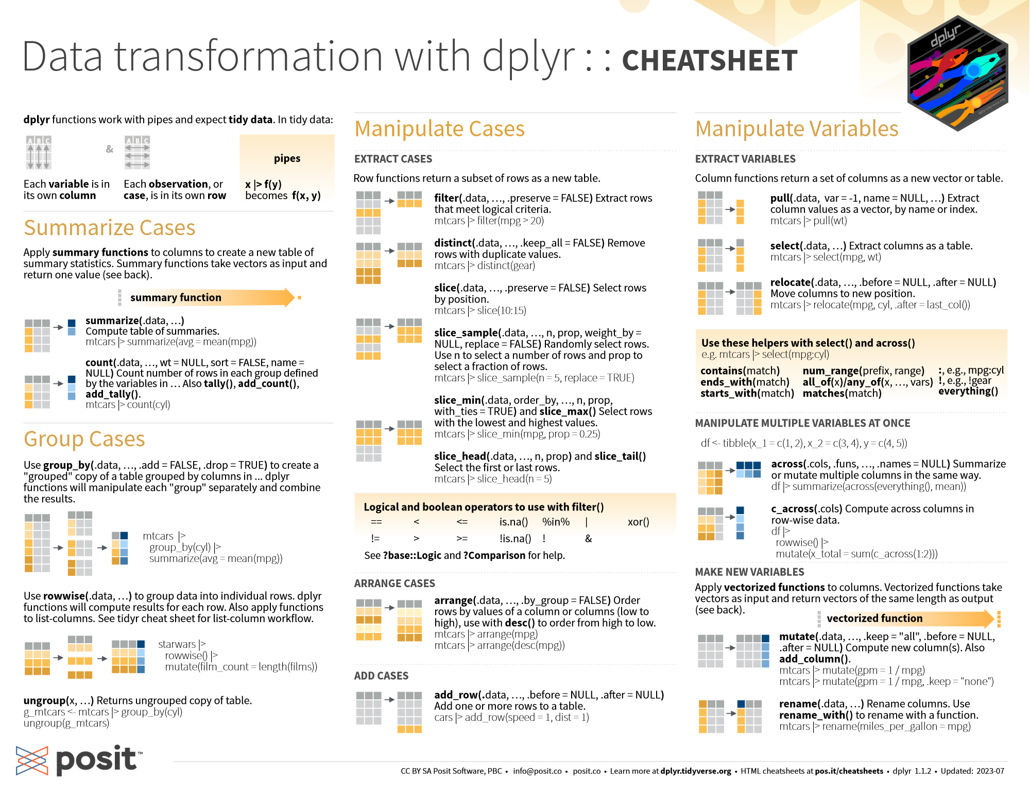
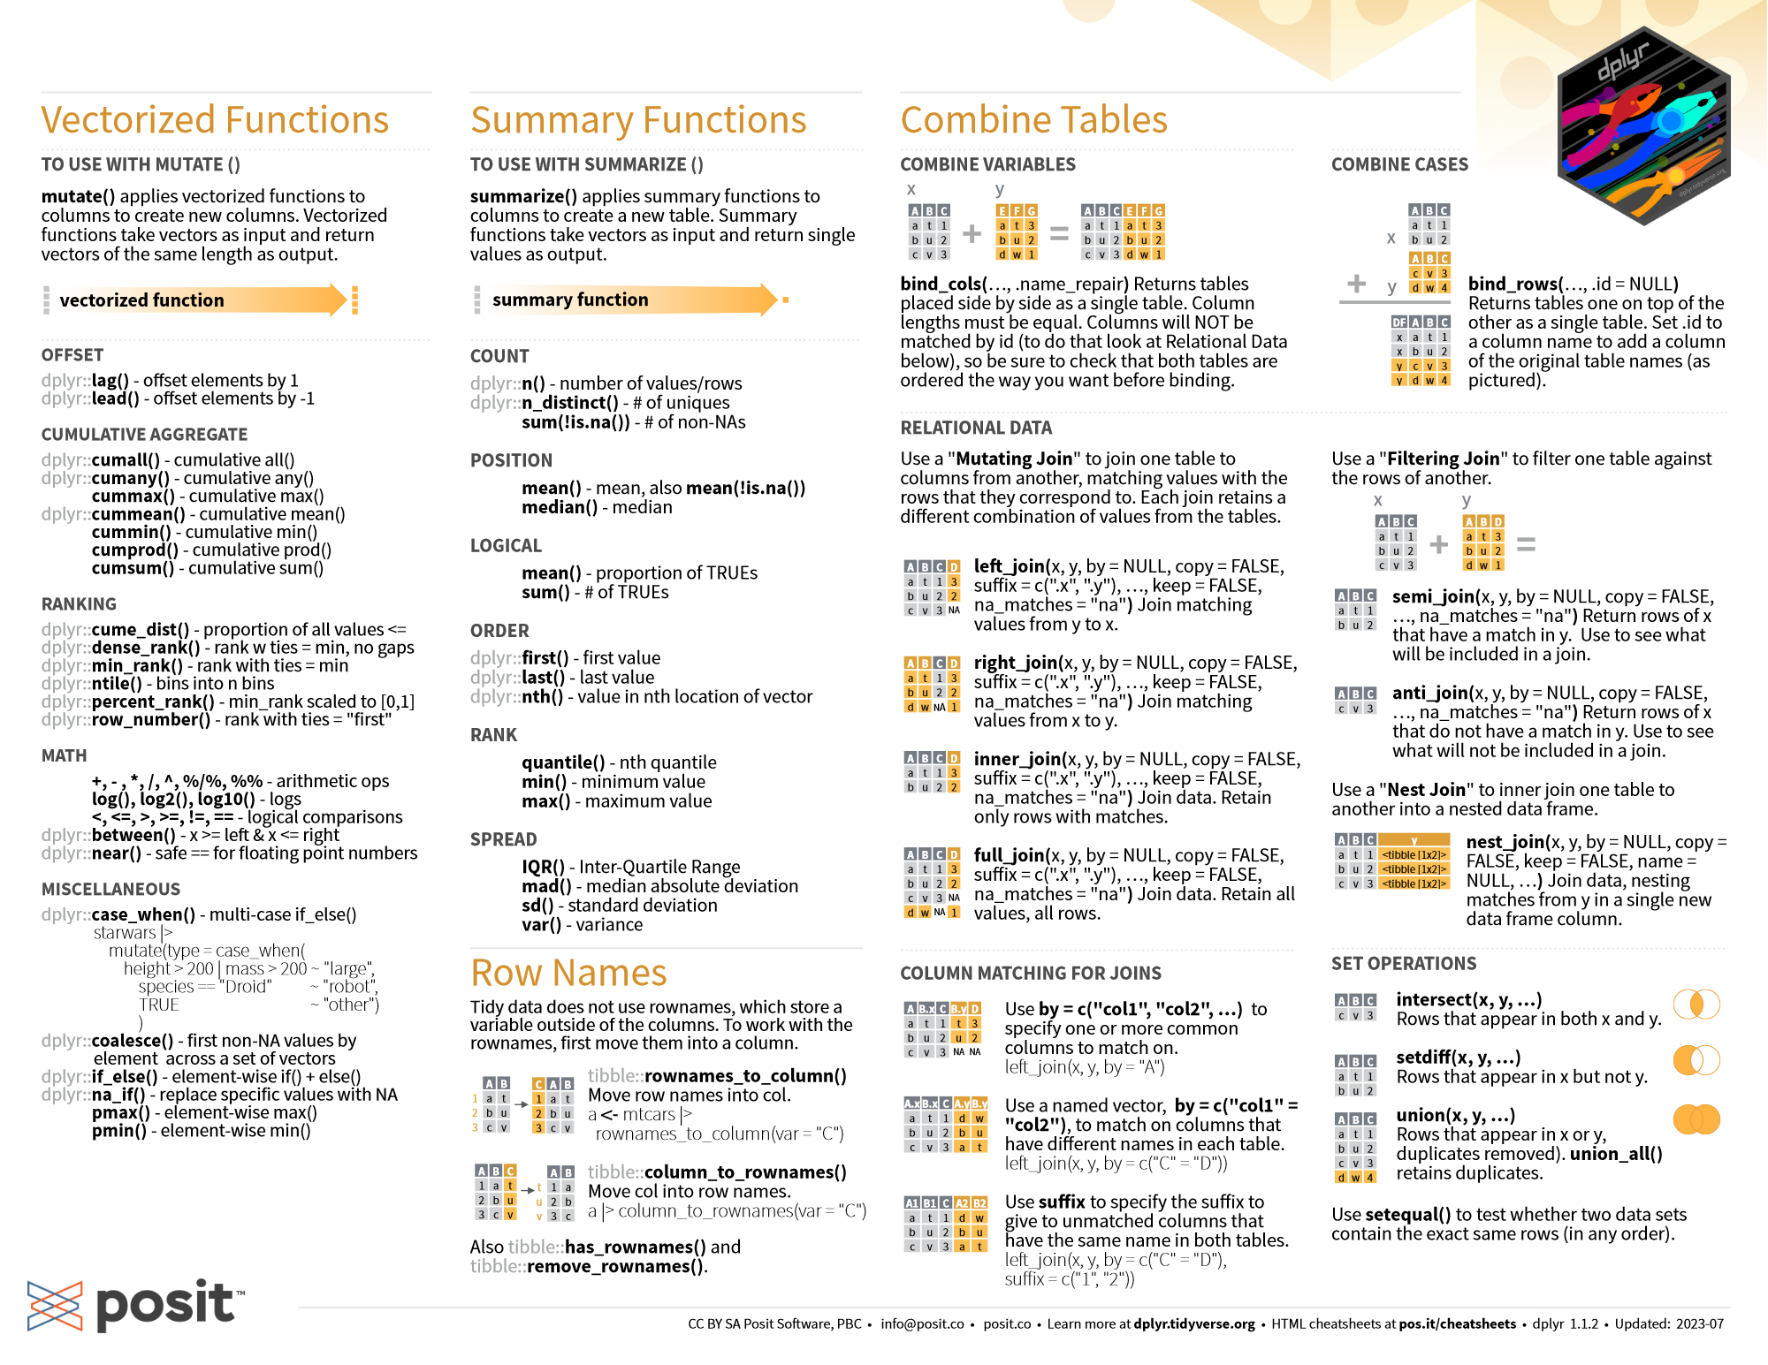
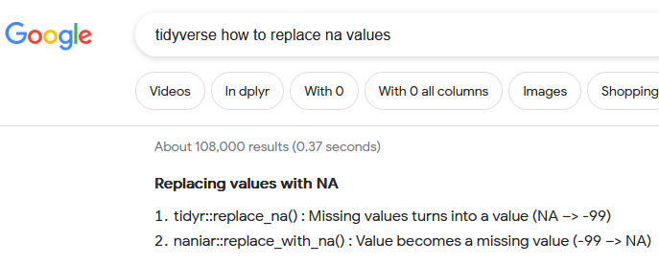
…and many more…
https://cran.r-project.org/web/packages/dplyr/vignettes/dplyr.html
https://www.tidyverse.org/
Notes:
And … many many more.
Generally, if you find yourself thinking “I bet someone has done this data operation before”, there’s probably a tidyverse function for it.

Slide 40
Review: Data
Reading in Data
Use read_csv(“subfolder/filename.csv”)
Problems? Did you use correct:
Filename
Subfolder name
Are you in the correct directory?
Use str() to check the types
Use View() to inspect dataframe
Refer back to this when doing own project later today
Notes:
So for the benefit of our PROJECT section later, here’s a bit of data review…

Slide 41
Pipe %>%
dataframename1 <- filter(dataframename_raw, Year == 2018)
dataframename2 <- mutate(dataframename1, surveymonth = month(surveydate))
dataframename3 <- select(dataframename2, Year, surveymonth, totalcount)
dataframename <- dataframename_raw %>%
filter(Year == 2018) %>%
mutate(surveymonth = month(surveydate)) %>%
select(Year, surveymonth, totalcount)
Notes:
And here’s a quick review of the pipe operator, and how it acts.

Slide 42
Functions we’ve seen
select(): Select a subset of columns
Note: it can be preferable to call dplyr::select(), to avoid conflict with MASS::select(). The MASS package also has a function named select()!
filter(): Filter to a subset of rows
mutate(): Add a column or transform an existing one
rename(): Rename columns
left_join(): Join two data.frames based on a matched column
group_by() & summarise(): Create a new summary data.frame, much like a pivot table
pivot_longer() / pivot_wider(): Transform between long & wide format

Slide 43


Which to use? Why??
Both are valuable!!
Tidyverse is VERY powerful for big data tasks
But, base R can be good for very specific cases
Lots of help is available in base R, so it’s good to be able to read it
Base R is more static & stable
The power of the pipe!!!
Notes:
So! Circling back.

Slide 44
Which to use? Why??
Answer: it’s handy to be able to use both!
Tidyverse is very powerful
Notes:
So! Circling back.

Slide 45
Some data cleanup strategies… It all starts with finding the problems!
Some helpful summary functions:
names() - prints column names of a data.frame, or names of a list
str() - prints the structure of an object
summary() - prints a summary specific to an object type
head() and tail() - prints the first (or last) few rows or elements
table() - creates a table of unique values
table() everything that can be tabled
Suggestion: table(xxx, useNA="ifany")
table(xxx, yyy, useNA="ifany")
plot() everything that can be plotted
This will print unique combinations
Notes:
And everyone who works with data has their own strategies, but here are a few of mine…
After importing…. The first step in FIXING the problems is FINDING the problems, and R has some quick summary tools that will tell you a lot.

Slide 46
A few magical tricks from external packages…
For fixing text:
tolower() and toupper() standardizes a vector or column of text to all lower or upper case
str_trim() removes beginning & ending spaces of a vector or column of text
str_squish() removes beginning & ending spaces, and also collapses inner whitespace
janitor::clean_names() cleans the names of a data.frame
snakecase::to_snake_case() standardizes all text to snake_case
snakecase::to_any_case() standardizes text to any case specified
R shorthand: package::function()
Part of base R
Loaded with tidyverse
Notes:
Text can be a NIGHTMARE.
Capitalization … trailing spaces … things with spaces but different numbers of spaces … trailing spaces after numbers so it makes the whole column CHARACTER …
Thankfully there are a few tools that can fix a LOT of these problems, and can be added to a pipeline.

